Slide 1
West Bengal Minor Minerals (Auction Rules) , 2016
Notification No. 430-CI/O/MM/11 (part-II)
Dated 29 / 07 / 2016
by the C I & E Department,
Govt. of West Bengal.

Slide 2
What’s New
Grant of Mining Lease for exploitation of Minor Minerals shall be made only through competitive bidding ( A U C T I O N )

Slide 3
Rule 3 : Application
To all minor minerals as specified in clause (e) of section 3 of MM ( D & R ) Act, 1957
To 31 reclassified minerals declared by the Central Govt. as minor minerals vide notification S.O. 423 ( E ) dated 10 / 02 / 2015

Slide 4
Rule 7 : Electronic Auction
Auction of any Minor Minerals shall be conducted only through an on line Electronic Auction Platform
Government eProcurement System
[ http://eauction.gov.in ]...... Live site
[ http://demoeproc.nic.in ] …… Demo site

Slide 5
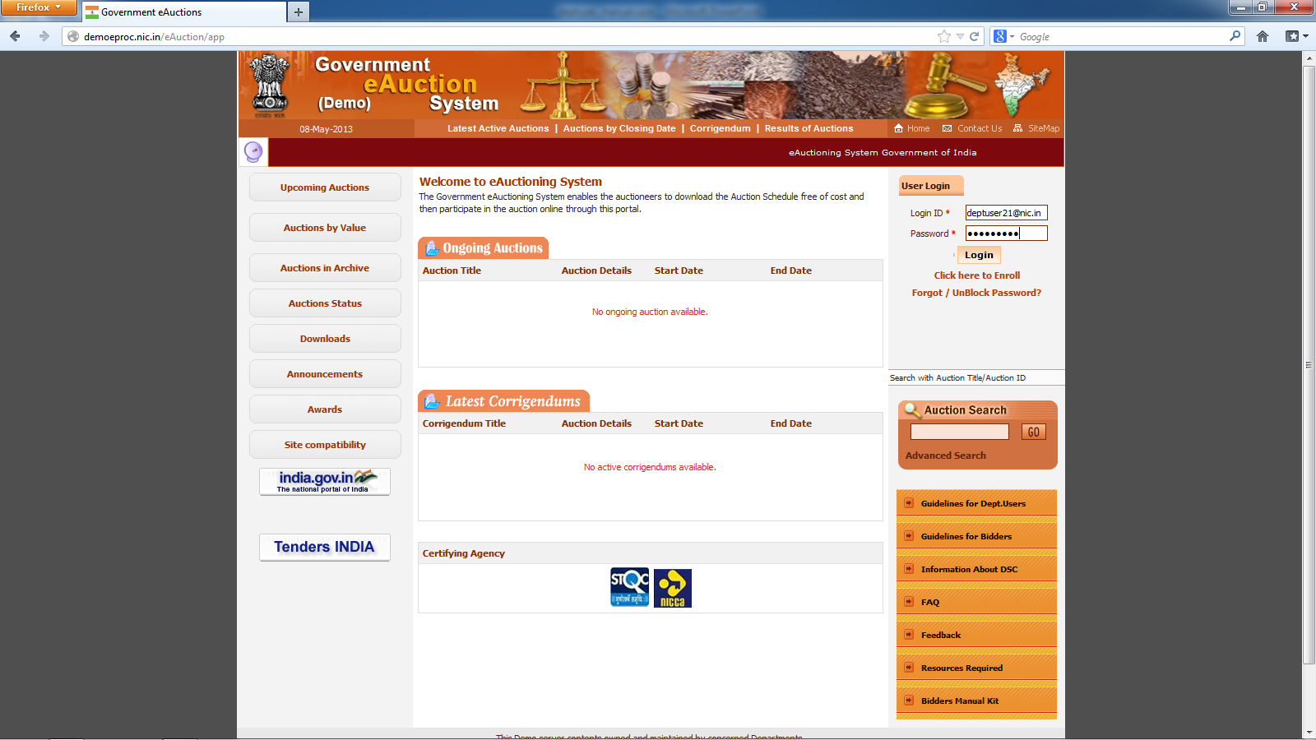

Slide 6
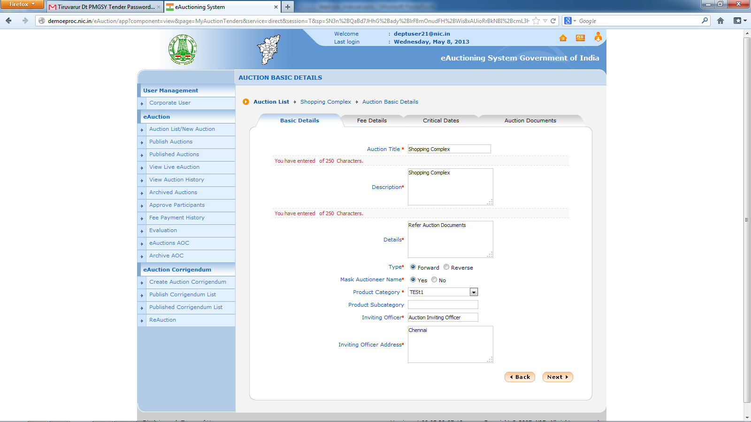

Slide 7
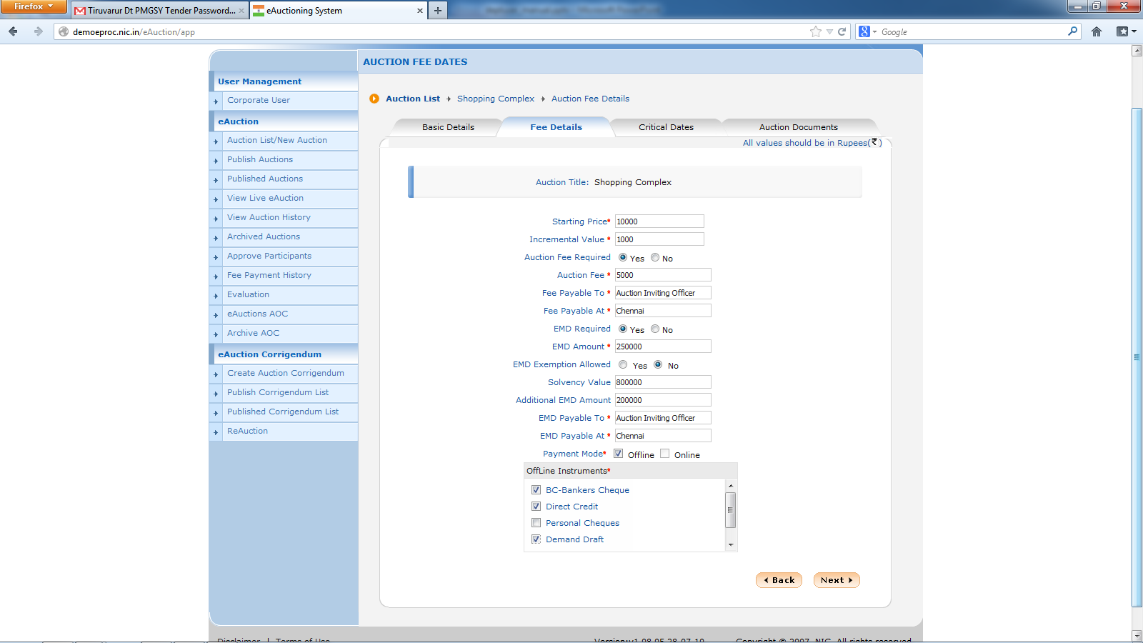

Slide 8
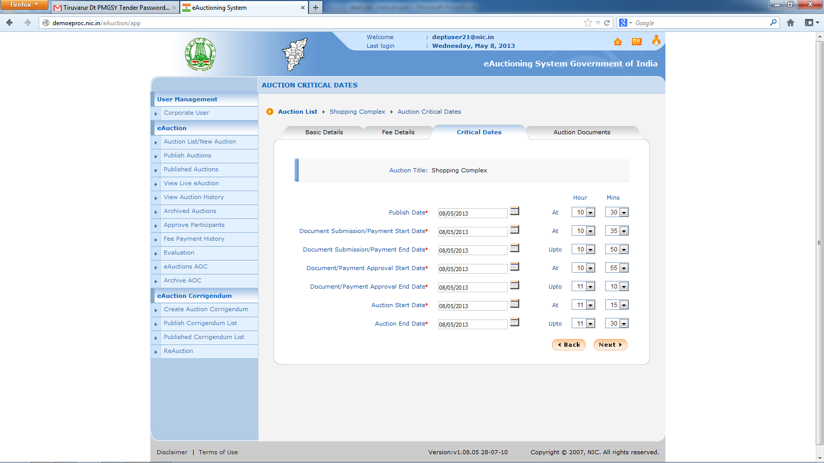

Slide 9
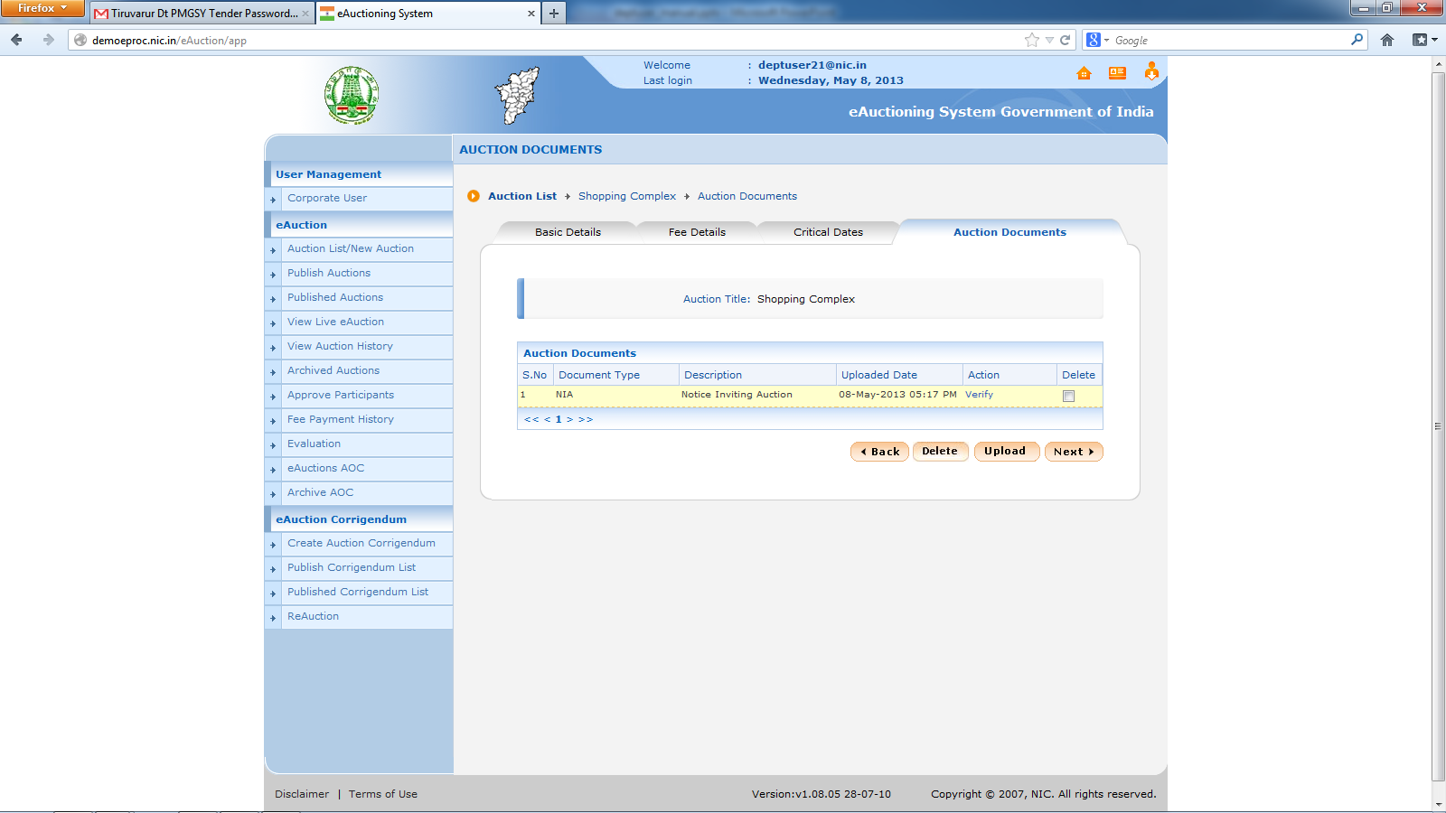

Slide 10
Rule 2 : Definitions
“Act” – Mines & Minerals (Development & Regulation) Act , 1957 (as amended)
“Bid amount” – amount quoted on & above the reserve price by the successful bidder

Slide 11
Definitions
“District Committee” – District Committee for Competitive Bidding for the purposes of Rule 6 , 8 & 9
“Reserve Price” – minimum % of value of mineral despatched in a month

Slide 12
Rule 2(d) : District Committee
Notification No.
438-CI/O/MM/84/(Pt-II)
Dated 01 / 09 / 2016

Slide 13
District Committee Composition
District Magistrate (Chairperson)
ADM & DL & LRO (Member Secretary)
Divisional Forest Officer
Mining Officer of the District
All Sub – Divisional Officers
Executive Engineer , I & W Deptt
Executive Engineer , PWD (nominated by DM)
Representative of the W B P C B
Geologist of S W I D

Slide 14
Function of District Committee
Conduct of entire Auction process starting from selection of mineral block till declaration of the Successful Bidder

Slide 15
Rule 5 : Prerequisites for Auction of mining Lease
Identification of mineral blocks
Demarcation of the mineral blocks
Proof of mineral content

Slide 16
Rule 6 : Eligibility for Mining
Persons perticipating in auction must be an Indian National
Persons perticipating in auction must be technically & financially qualified as determined by the District Committee
Meet the requirements as prescribed in the Mining Lease Deed

Slide 17
Rule 8 : Bidding Parameters
DC shall fix the Reserve Price (RP) for each Minor Mineral to be auctioned
The RP shall not be below 75% of the value of the mineral despatched in rupee terms
Value of mineral = {MM despatched in a month} X {sale price of MM}

Slide 18
Bidding Parameters Continued
Sale price of MM as notified by the PWD without transportation cost / for 31 reclassified MM as notified by the IBM
Eligible bidder shall quote price above the RP in multiple of Rs.1000/-

Slide 19
Rule 9 : Bidding Process
The DM shall issue notice inviting tender for e-Auction through publication in news paper & in the state/district website
DM shall issue Tender Document (TD) which shall contain brief particulars/ revenue survey details of the area under auction

Slide 20
Bidding Process Continued
The TD shall also contain the date/time of submission of application and auction . It shall also contain particulars like other terms & conditions for auction and penal measures for violating such conditions

Slide 21
Bidding Process Continued
The bidders shall be provided a fixed period to study the TD /reports & bidding shall commence on expiry of such period
Bidders shall submit 10% of RP as Earnest Money (EM)
EM shall be refundable to all bidders except the successful bidder

Slide 22
Bidding Process Continued
EM to be adjusted with the bid amount of successful bidder
Auction shall be ascending forward online electronic auction under the supervision of DC
The DC shall declare the name of the successful bidder

Slide 23
Rule 10 : Grant of Mining Lease
The successful bidder shall pay 1/3 of the bid amount within 15 days of such declaration by the DC
The DM shall issue LoI directing compliance of all terms & conditions as laid in the Act & Rules

Slide 24
Grant of Mining Lease Contd..
Mining Lease shall be executed by the DM within 30 days of compliance of conditions of Chapter –III & V of WBMMC Rules, 2016 and in the LoI
The successful bidder who have submitted 1/3 of bid money may commence mining operations after registration of a duly executed lease

Slide 25
Grant of Mining Lease Contd..
The date of registration of duly executed Mining Lease is the date of commencement of the Mining Lease period

Slide 26
Payment of Rest of Bid Amount
The balance of the bid money shall be payable in 3 installments with a gap of maximum 45 days each from the 1st installment, which in no case exceed the lease period or closure of mining operations

Slide 27
Payment of Rest of Bid Amount
Continued
No relaxation in the periodicity of deposition of rest of bid money is allowed & in case of delay , the mining lease shall be cancelled

Slide 28
Rule 11 : Performance Security
The successful bidder shall provide a performance security in the form of bank guarantee for an amount of 10 % of the bid amount

Slide 29
Rule 16 : Power to rectify apparent mistakes
Any clerical or arithmetical mistakes in any order passed by the DM or any authority or Officer under these rules and any error arising therein due to accidental slip or omission may be corrected by the DM or the concerned authority or Officer, as the case may be.

Slide 30
Auction process in Nut Shell
Identification of Mineral Block
Demarcation of Mineral Block
Proof of Mineral Content
Fixation of Reserve Price
Issuance of Notice inviting Auction
Publish of Tender Document in e Auction Portal

Slide 31
Auction process contd
Uploading of other reports
Fixation of Critical Dates
Receipt of Earnest Money
Evaluation of prospecting bidders
Start of Auction under supervision of DC
Selection of Successful Bidder by the DC

Slide 32
Preparation of Mining Lease
Payment of 1/3 of Bid Money within 15 days
Issuance of LoI by the District Magistrate
Compliance of terms & conditions in LoI
Fixing dates for payment of rest Bid Money
Execution of Lease Deed within 30 days
Registration of executed mining lease by DM
Handing over Possession of leased out area

Slide 33
THANK YOU

